Slide 1

Network Layer: IPv4 Static Routing
Lecture 11 | CSE421 – Computer Networks
Department of Computer Science and Engineering School of Data & Science

Slide 2
Objectives
Static Routing
Standard static routing
Directly Attached / Connected
Next Hop / Recursive
Default Routing
Floating Static Routing

Slide 3
Learning About Networks
A router can learn about remote networks in one of two ways:
Manually - Remote networks are manually entered into the route table using static routes.
Dynamically - Remote networks are automatically learned using a dynamic routing protocol.
Notes:
3
6.1.1.1

Slide 4
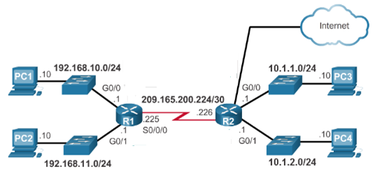
Learning About Networks
Table of R1
Network | Exit Int
192.168.10.0/24 | G0/0
192.168.11.0/24 | G0/1
209.165.200.224/30 | S0/0/0
Table of R2
Network | Exit Int
10.1.1.0/24 | G0/0
10.1.2.0/24 | G0/1
209.165.200.224/30 | S0/0/0
220.20.20.0/30 | G0/2
20.20.20.0/30
Directly connected
Directly connected
10.1.1.0/24
S0/0/0
10.1.2.0/24
S0/0/0
192.168.10.0/24
S0/0/0
192.168.11.0/24
S0/0/0
S0/0/1
S0/0/0

Slide 5
Static Route
Manually configured route
Used to reach networks not directly connected
Does not update automatically
Changes must be applied manually
Notes:
If there is no dynamic routing protocols

Slide 6
Static Route Types
Static Routes are often used to:
Reach a specific remote network
Set a default route (gateway of last resort)
Provide a backup path (floating static route)
Reduce routing table entries (summarization)
Notes:
6
Reduce the number of routes advertised by summarizing several contiguous networks as one static route

Slide 7
Static Route : How??
20.20.20.0/30
R1(config)#
command
Parameter 1
Parameter 2
Parameter 3
ip route
The remote network address
Subnet Mask
Exit interface or next hop IP address
R1(config)#
ip route
10.1.1.0
255.255.255.0
S0/0/0
209.165.200.226
Notes:
7
6.2.1.1

Slide 8
Routing Table of R1 after the static route command
Using Exit interface
R1# show ip route
C 192.168.10.0/24 is directly connected, GigabitEthernet0/0
C 192.168.11.0/24 is directly connected, GigabitEthernet0/1
C 209.165.200.224/30 is directly connected, Serial0/0/0
S 10.1.1.0/24 is directly connected, Serial0/0/0
Using next hop IP address
R1# show ip route
C 192.168.10.0/24 is directly connected, GigabitEthernet0/0
C 192.168.11.0/24 is directly connected, GigabitEthernet0/1
C 209.165.200.224/30 is directly connected, Serial0/0/0
S 10.1.1.0/24 [1/0] via 209.165.200.226

Slide 9
Recursive Lookup
R1# show ip route
C 192.168.10.0/24 is directly connected, GigabitEthernet0/0
C 192.168.11.0/24 is directly connected, GigabitEthernet0/1
C 209.165.200.224/30 is directly connected, Serial0/0/0
S 10.1.1.0/24 [1/0] via 209.165.200.226
20.20.20.0/30
Router R1 receives a packet which has the destination address is 10.1.1.24
How many times did the Router R1 look up the routing table?

Slide 10
Routing Table of R1 after the static route command
Using next hop IP address
R1# show ip route
C 192.168.10.0/24 is directly connected, GigabitEthernet0/0
C 192.168.11.0/24 is directly connected, GigabitEthernet0/1
C 209.165.200.224/30 is directly connected, Serial0/0/0
S 10.1.1.0/24 [1/0] via 209.165.200.226
Type of route:
S - Static
Destination Network
Cost of Path
Next Hop IP
Or, Exit Interface
Administrative
Distance
AD : The trustworthiness of the source of the route

Slide 11
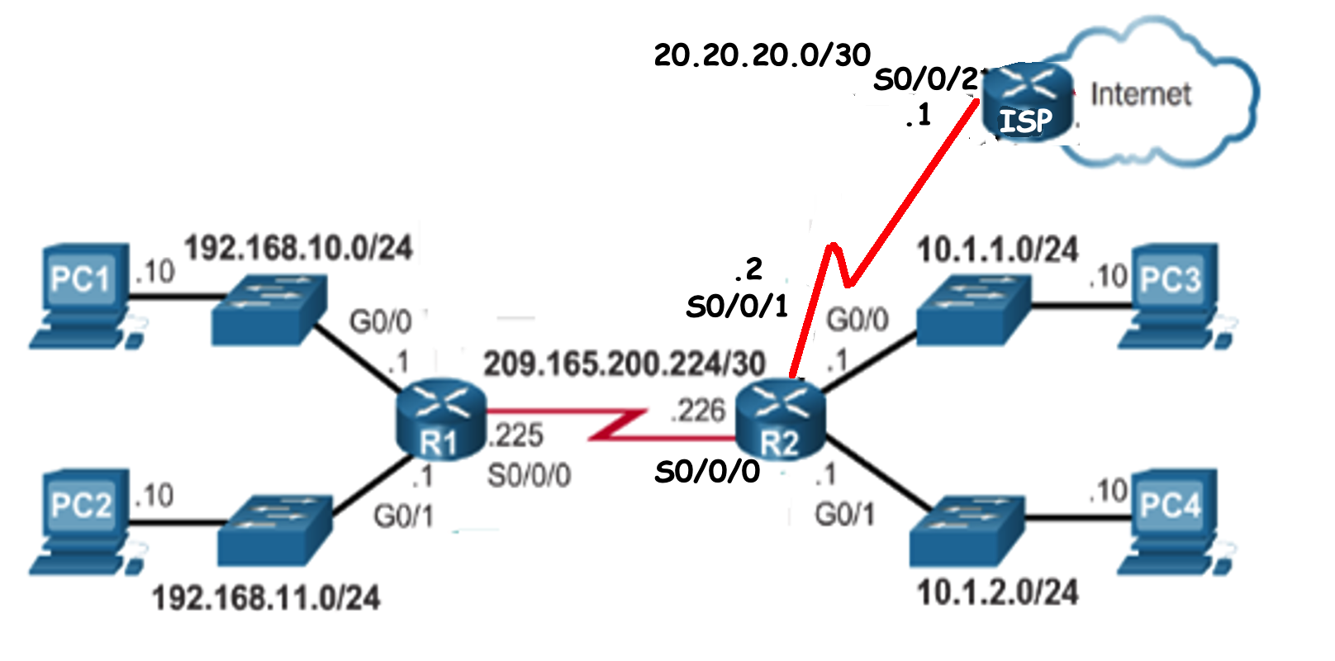
Default Route
All PCs of R1 and R2 need to go to the Internet ….
ip route 0.0.0.0 0.0.0.0 s0/0/1

Slide 12
ip route Command
ip route 0.0.0.0 0.0.0.0 s0/0/0
What about R1?
The remote network address
Subnet Mask
Exit interface or next hop IP address
ip route
R2(config)#
ip route
0.0.0.0
0.0.0.0
S0/0/1
Any network
Notes:
12
6.2.1.1

Slide 13
Default Static Route in the Routing Table
R1# show ip route
C 192.168.10.0/24 is directly connected, GigabitEthernet0/0
C 192.168.11.0/24 is directly connected, GigabitEthernet0/1
C 209.165.200.224/30 is directly connected, Serial0/0/0
S 10.1.1.0/24 [1/0] via 209.165.200.226
S* 0.0.0.0/0 is directly connected, Serial0/0/0

Slide 14
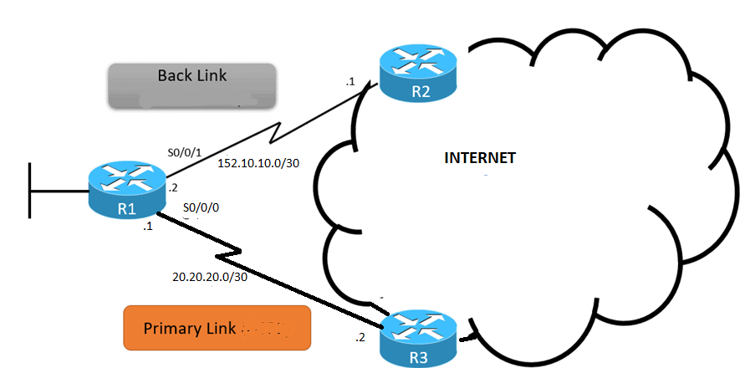
Floating Static Routing
Source : https://study-ccna.com/floating-static-route/

Slide 15
Floating Default Static Routing
R1 Routing Table (Partial)
S* 0.0.0.0/0 is directly connected, S0/0/0
S* 0.0.0.0/0 is directly connected, S0/0/1
Both has same cost same AD. Which one to use?
Present in Routing Table
R1(config)#ip route 0.0.0.0 0.0.0.0 S0/0/0
R1(config)#ip route 0.0.0.0 0.0.0.0 S0/0/1
5
AD > default Value
Present in Router Configuration File

Slide 16
Static Route Advantages
Simple and predictable
More secure (not advertised)
Low CPU/memory usage
Notes:
16
Advantage of static routing
It is most secure way of routing, since no information is shared with other routers.
It puts no overhead on resources such as CPU or memory.
No routing algorithm or update mechanisms are required. Therefore, extra resources (CPU and memory) are not required.
It is easy to implement.

Slide 17
Static Route Disadvantages
Time-consuming to configure
Not scalable for large networks
No automatic failover
Requires full network knowledge
Notes:
17
6.1.1.2

Slide 18
The End

